Slide 1
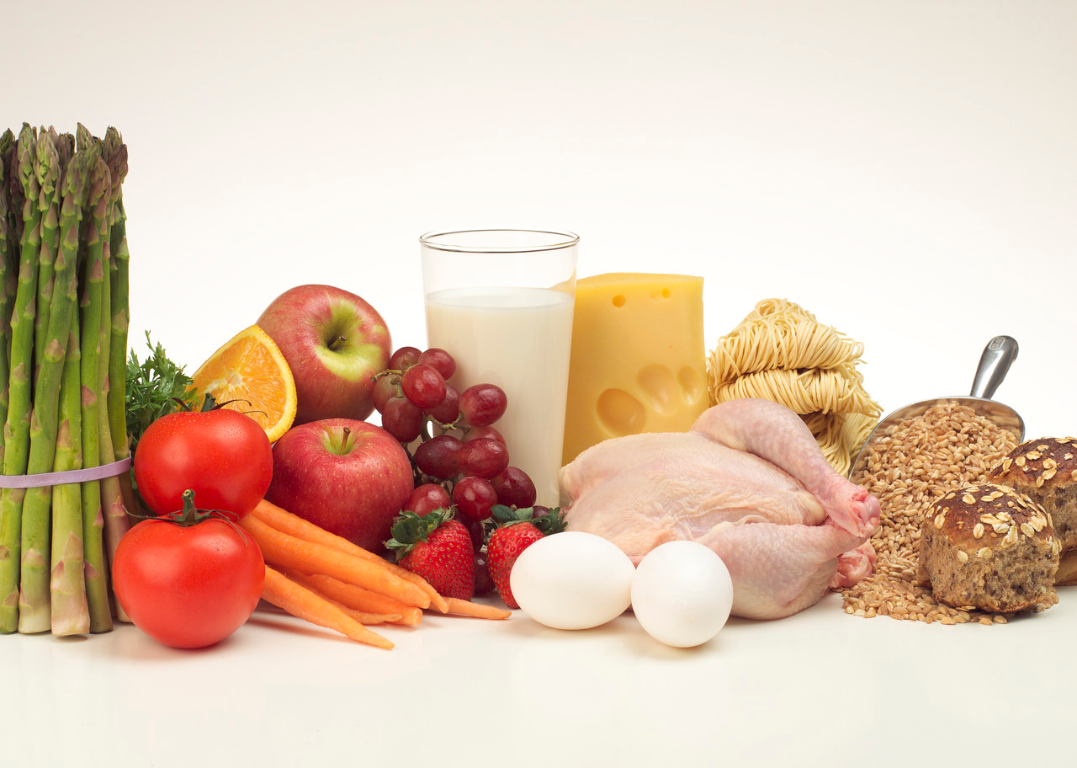
All About Nutrition

Slide 2


Why is Breakfast Important?
http://www.consumerreports.org/cro/magazine/2014/10/why-eating-the-right-breakfast-is-so-important/index.htm

Slide 3
Importance of Nutrition
To obtain energy and nutrients required for daily living
Hunger – physiological need to eat
Appetite – psychological; desire to eat
  Personal preferences
  Social Interaction
  Availability, convenience, economy
  Emotional comfort
Notes:
Why do we eat?

Slide 4
Important Concept
Calorie: amount of fuel a food provides to the human body
  Fats (9 kcals per gram)
  Carbohydrates (4 kcals per gram)
  Proteins (4 kcals per gram)
2,000 recommended daily caloric intake
3,5o0 calories in one pound of fat

Slide 5

Six Nutrients
Nutrients: substances in food that your body needs to stay healthy
Carbohydrates
Protein
Fat
Minerals
Vitamins
Water

Slide 6

Water
Function: most essential nutrient
  Helps digest and absorb food
  Regulates body temperature and blood circulation
  Carries nutrients and oxygen to cells
50-60% of our body weight
6-8 cups a day (64 oz.)
Notes:
Water is in food too
Urine should be clear, light or bright yellow
Dark yellow urine is a sign of dehydation

Slide 7
Carbohydrates
Function: to provide fuel/energy to the body
  50% of daily calories
Examples: whole-grains, rice, pasta
Two types:
  Simple Carbohydrates
  Complex Carbohydrates
Notes:
Grains are a good source of Carbs
Food Sources
Whole wheat breads
Rice
Pasta
Potatoes

Slide 8
Complex Carbohydrates
Starch: storage form of sugar (glucose) in plants
  Fuel for human health, broken down to glucose
  Examples: potatoes, corn, green peas
Fiber: structural part of plants
  No energy or calories
  Provides fecal bulk (cannot be digested)
  Protection against constipation
  Examples: whole-grain, fruits, vegetables
Notes:
Cannot be digested or absorbed – so the body gets rid of it
Starch = “the other carbohydrate” on the food label
Fruits = apples, organes, bananas, berries, prunes
Veggies = green peas, broccoli, spinach
Insoluble fiber. This type of fiber promotes the movement of material through your digestive system and increases stool bulk, so it can be of benefit to those who struggle with constipation or irregular stools. Whole-wheat flour, wheat bran, nuts and many vegetables are good sources of insoluble fiber.
Soluble fiber. This type of fiber dissolves in water to form a gel-like material. It can help lower blood cholesterol and glucose levels. Soluble fiber is found in oats, peas, beans, apples, citrus fruits, carrots, barley and psyllium
Two forms: soluble and insoluble
Soluble fiber
Found in oat bran, dried beans, fruits/vegetables
Lowers blood cholesterol levels
Insoluble fiber
Found in bran, whole-grains, fruits/vegetables
Aids digestion

Slide 9
Simple Carbohydrates (Sugars)
Depends on the chemical structure of the food and how quickly the sugar is digested and absorbed
  Monosaccharides
    Glucose (blood sugar)
    Fructose (sugar in fruit)
    Galactose (sugar in milk)
  Disaccharides
    Sucrose (table sugar)
    Lactose (milk)
    Maltose (sugar produced from breads, cereals)

Slide 10
Fat (Lipids)
Function: provides fuel, insulation, shock absorption, hormone regulation
  Feeling of fullness or satisfaction after eating
  Provides 9 calories (kcals) per gram
  20-35% or less of daily calories
Saturated – animal sources
  Fats that are solid and room temperature
Unsaturated – plant sources
  Fats that remain liquid at room temperature
Notes:
If fats that a person has eaten aren’t burned as energy or used as building blocks, they are stored by the body in fat cells. This the body’s way of thinking ahead…by saving fat for future use. It plans for times when good might be scarce
**We all require a certain amount of fat and calories in our diets to fuel our growth and activities.

Slide 11
Fats: Cholesterol
Cholesterol: waxy substance produced by liver that helps digest fat
  Produced by liver
  Found in animal sources (dietary cholesterol)
  HDL: removes cholesterol from the blood vessels and carries it back to the liver
  LDL: clogs the blood vessels, keeping blood from flowing
Notes:
1,000 milligrams of cholesterol a day and you consume about 150-250 miligrams in the foods you eat
Don’t need to eat more because our body makes enough for us
removes cholesterol from the blood vessels and carries it back to the liver , where it can be processed and sent out of the body
Exercise helps increase hdl to remove its
Ldl = too much cholesterol in body

Slide 12
Protein
Function: component of vital body growth and repair
  Tissue growth and maintenance
  Transfer and store water at cellular level
  Antibodies
  Blood clotting
10-15% of daily calories
Examples: milk, meat, vegetables, breads and starches
Notes:
Sources: milk, meat, vegetables, breads and starches
Meat group is good source of protein

Slide 13
Protein: Incomplete & Complete
Essential Amino Acids: proteins your body cannot create
Complete – animal sources
  Provides all essential amino acids
  Examples: Meat sources (beef, pork, fish)
Incomplete – plant sources
  Missing one or more essential amino acids
  Examples: Vegetables, breads, and milk
Notes:
**MUST BE PROVIDED BY FOOD
Made of amino acids
- 9 essential amino acids
- must come from diet, complete proteins contain all 9 essential aminos *meat sources and soy bean products)
- Incomplete proteins (plant sources) can be combined to provide all essential amino acids

Slide 14
Minerals
Function: inorganic elements that aid the body’s processes
  Aid absorption of vitamins
  Healthy bones and teeth
  Muscle contraction
  Readily excreted (water soluble)
Electrolytes: help regulate the balance of fluids in the body’s cells and bloodstream
Notes:
Inorganic substances that body cannot manuafature

Slide 15
Minerals: Calcium & Iron
Calcium: build and maintain strong bones and teeth
  Examples: dairy products, dark-green leafy vegetables (spinach)
Iron: helps red blood cells carry oxygen, increases immunity
  Examples: red meat, pork, fish, leafy vegetables
Notes:
Lead to osteporosis
Increased immunity – resistance to cold

Slide 16
Major Mineral: Sodium
Sodium
  Regulates amount of water in the body
  Regulates blood and body fluids
  Only 500-1000 mg needed per day
    Average American consumers 6000-12000 mg
  Excessive amounts may lead to high blood pressure
Examples: processed foods

Slide 17
Vitamins
Function: organic compounds that promote growth and reproduction and help maintain your health
  Help maintain nerves and skin
  Produce blood cells
  Build bones and teeth
  Help wounds heal better
Fat Soluble - - stored in the body
  Vitamins: A, D, E, K
Water Soluble - - excess goes through body
  B-Vitamins and Vitamin C
Notes:
Organic compounds that regulate and promote chemical reactions, do not provide energy
Fruits and vegetables are good sources of vitamins
Water Soluble
Excess goes through body
B-Vitamins, Vitamin C
Fat-Soluble:
Stored in body
Vitamins: A, D, E, K

Slide 18
Vitamins: Fat & Water Soluble
Fat Soluble:
  Vitamin A: healthy skin and vision
    Examples: dark-green vegetables, yellow-orange fruits & vegetables
  Vitamin D: strong bones/teeth and absorption of calcium
    Examples: milk, fatty fish (salmon), egg yolks
Water Soluble:
  Vitamin C: healthy teeth, gums and bones; heal wounds and fight infection
    Examples: oranges, tomatoes, broccoli
  Folic Acid: essential for normal growth of cells
    Examples: dark-green vegetables, liver, orange juice
Notes:
Fat – dissolve in fat and can be stored in your body
Water – body is unable to absorb them, any extra your body doesn’t use passes through your ssytem and is low (mostly in your pee)
**so you need to supply of these vitamins every day

Slide 19
NUTRITION: Food Label Quiz

Slide 20
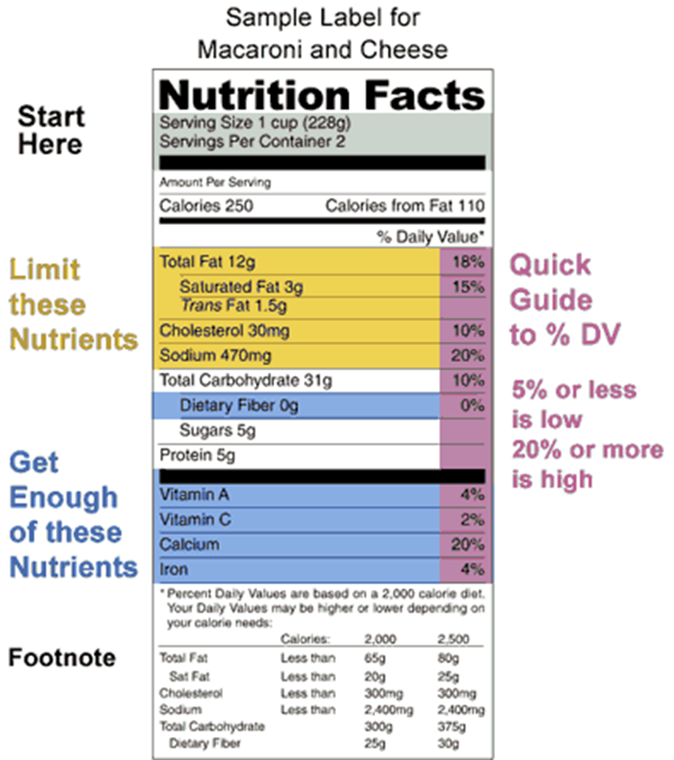
Food Label Quiz
1. Name the two minerals listed.
2. What major nutrient is never listed?
3. How many total calories are in this item?
4. If you consumed 2 servings of this item, how many mg. of sodium would you consume?
5. T or F The FDA doesn’t require food labeling on packaged foods.
6. Do you think this is a healthy food item? Why?
7. What popular food do you think this is?
8. List the major nutrients in the order located on the food label?

Slide 21









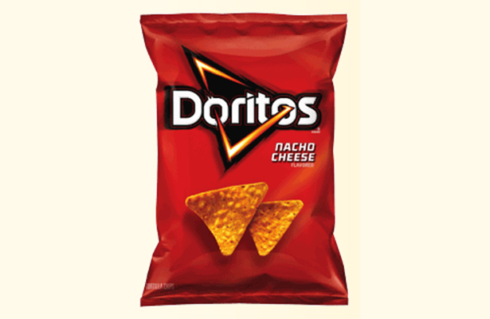

NUTRITION: Food Label Comparison https://www.youtube.com/watch?v=rgaqwFPU7cc&list=WL&index=23 https://www.youtube.com/watch?v=KMGUmcveQeg&list=WL&index=12

Slide 22






NUTRITION: Fast Food Menu http://www.youtube.com/watch?v=-ZzBUbwxfL0&safety_mode=true&persist_safety_mode=1 https://www.youtube.com/watch?v=rgaqwFPU7cc&list=WL&index=23 https://www.youtube.com/watch?v=KMGUmcveQeg&list=WL&index=12

Slide 23
FAT INTAKE
USDA (United States Department of Agriculture) recommends daily percent fat intake to be anywhere from 20-35% (no more than 35).
~10% Saturated (animal fats)
~20-25% unsaturated (fats from vegetables)
                A high intake of fat (greater than 35 percent of calories) generally increases saturated fat intake and makes it more difficult to avoid consuming excess calories. A low intake of fats and oils (less than 20 percent of calories) increases the risk of inadequate intakes of vitamin E and of essential fatty acids and may contribute to unfavorable changes in high-density lipoprotein (HDL) blood cholesterol and triglycerides.

Slide 24

Figuring Out Food’s
% of calories from FAT
(9X/Y)100
X= Total Fat Grams per serving
(You multiply by 9 since there are 9 calories per gram of fat.)
Y= Total calories per serving
Multiply above answer by 100 = % Fat
Skippy Peanut Butter
16 grams of fat, 190 calories per serving
(9X16/190)100=
(144/190)100=
(.7578)100=
=75%

Slide 25

Key Recommendations
Consume a healthy eating pattern that accounts for all foods and beverages within an appropriate calorie level. https://www.facebook.com/HHS/videos/1061761323854193/

Slide 26
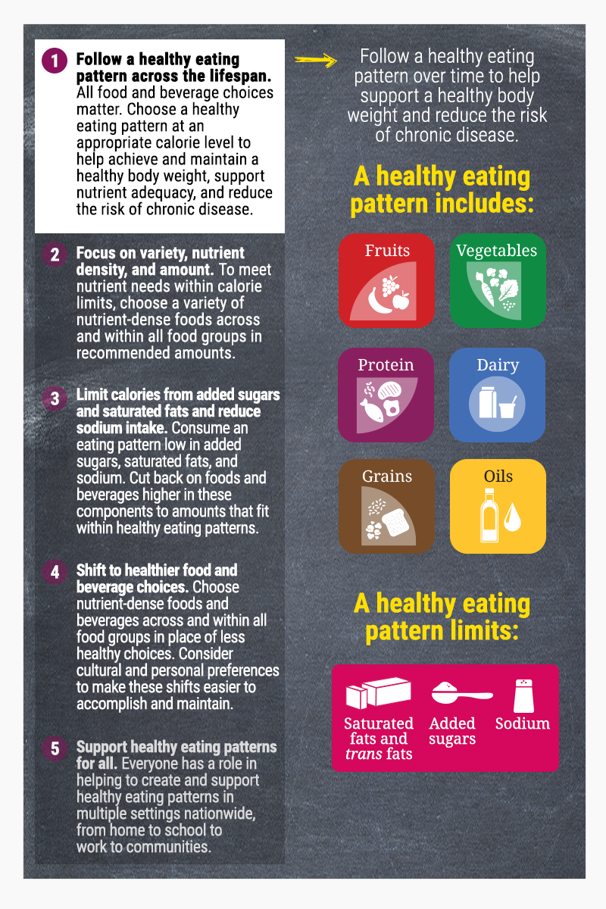
http://health.gov/dietaryguidelines/2015/guidelines/executive-summary/
https://www.youtube.com/watch?v=nmhAWCR8n3g

Slide 27
A healthy eating pattern includes:^{[2]}
A variety of vegetables from all of the subgroups—dark green, red and orange, legumes (beans and peas), starchy, and other
Fruits, especially whole fruits
Grains, at least half of which are whole grains
Fat-free or low-fat dairy, including milk, yogurt, cheese, and/or fortified soy beverages
A variety of protein foods, including seafood, lean meats and poultry, eggs, legumes (beans and peas), and nuts, seeds, and soy products
Oils

Slide 28
A healthy eating pattern limits:
Saturated fats and trans fats, added sugars, and sodium
Key Recommendations that are quantitative are provided for several components of the diet that should be limited. These components are of particular public health concern in the United States, and the specified limits can help individuals achieve healthy eating patterns within calorie limits:
Consume less than 10 percent of calories per day from added sugars^{[3]}
Consume less than 10 percent of calories per day from saturated fats^{[4]}
Consume less than 2,300 milligrams (mg) per day of sodium^{[5]}
If alcohol is consumed, it should be consumed in moderation—up to one drink per day for women and up to two drinks per day for men—and only by adults of legal drinking age.^{[6]}

Slide 29
AVERAGES
TEEN GIRLS TEEN BOYS
Avg. calories 2000 2800
Avg. total fat (g) 73 93
Problem:
Trish is a 16-year old female that is 5’4” and weighs 105 pounds. She gets less than 30 minutes of physical activity per day and wants to know approximately how many calories she should consume?
A. 1000-1200 C. 1800-2000
B. 3200-3400 D. 4500-4700

Slide 30
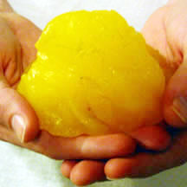
MATCH THE ANSWER
How many calories are there in one pound of fat?
How many calories are there per gram of fat?
How many calories per gram of Protein?
How many calories per gram of Carbohydrates?
ANSWERS: A. 4 B. 3,500 C. 9 D. 4

Slide 31
1) B: 3,500
2) C: 9
3) A or D : 4
4) A or D: 4

Slide 32
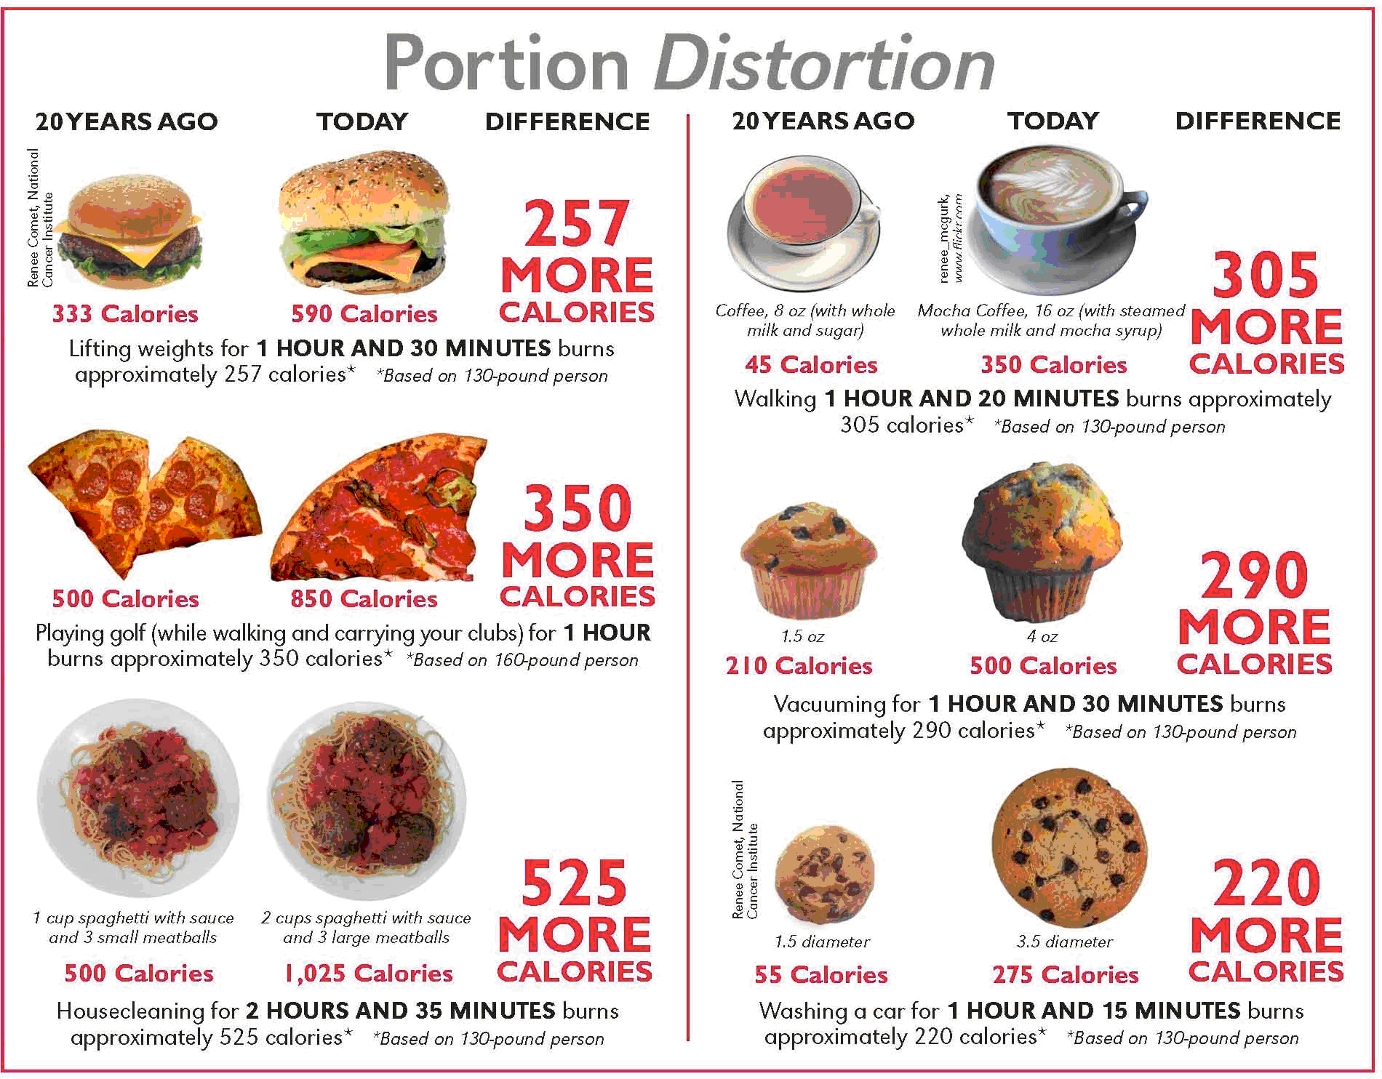
Portion Distortion?
https://www.youtube.com/watch?v=A6QnCdc6LkY&list=WL&index=21
https://www.youtube.com/watch?v=7yQmXWuH10g&index=21&list=WL

Slide 33

Move More, Eat Less
https://www.youtube.com/watch?v=VKs0oEIVOck&index=24&list=WL

Slide 34

ChooseMy Plate.gov worksheet
USDA Food Guidance System
5 FOOD
GROUPS

Slide 35
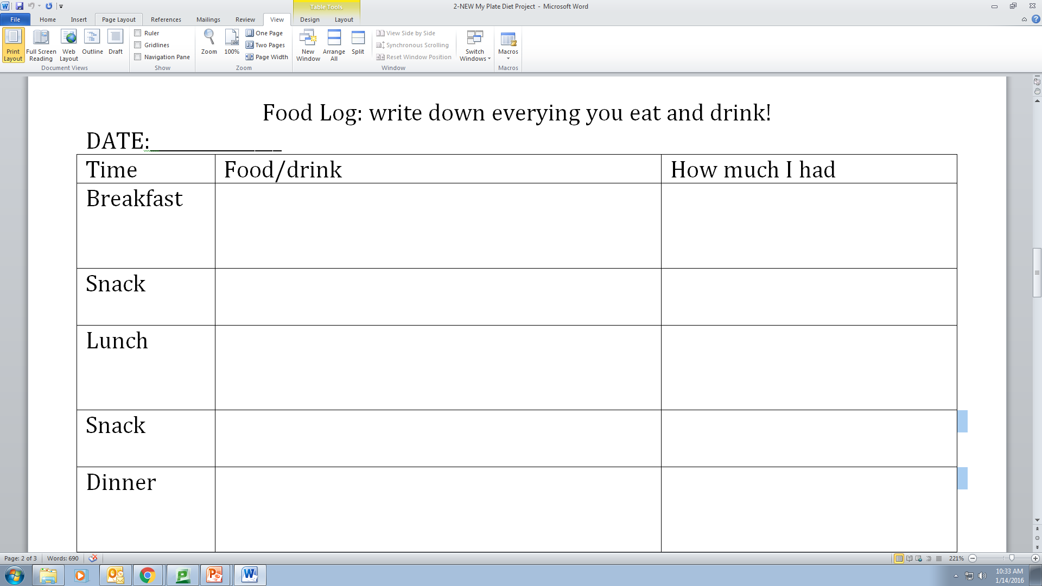
Part 1: Food Log

Slide 36

Part 2: Create Account

Slide 37
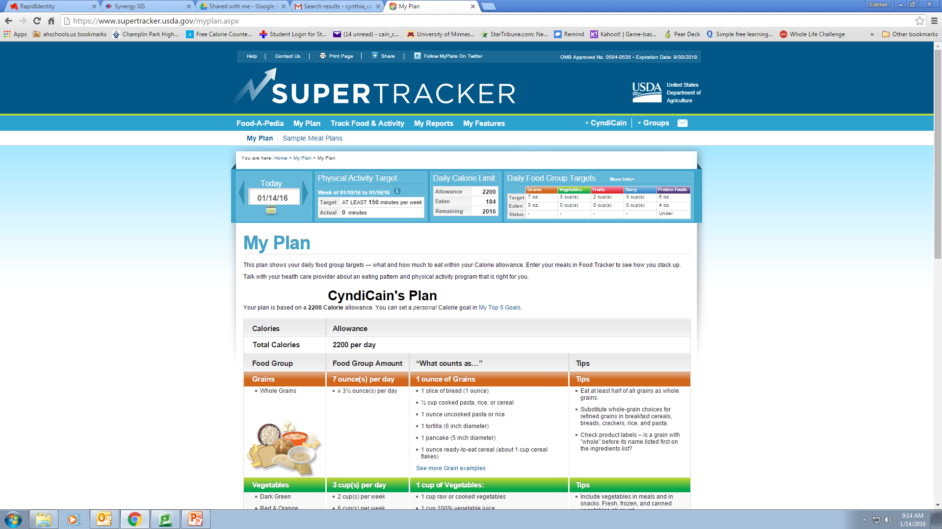
Part 3: Personalize Plan
Daily Calorie Limit | calories
Empty Calories | calories
Grains | oz.
Vegetables | cups
Fruits | cups
Dairy | cups
Protein Foods | oz.
Oils | tsp.

Slide 38
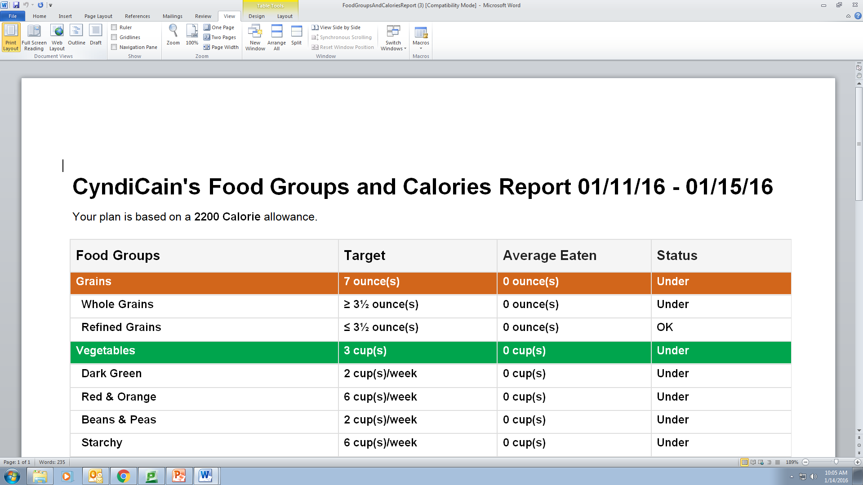
Part 4: My Reports: Food Groups & Cal0ries

Slide 39
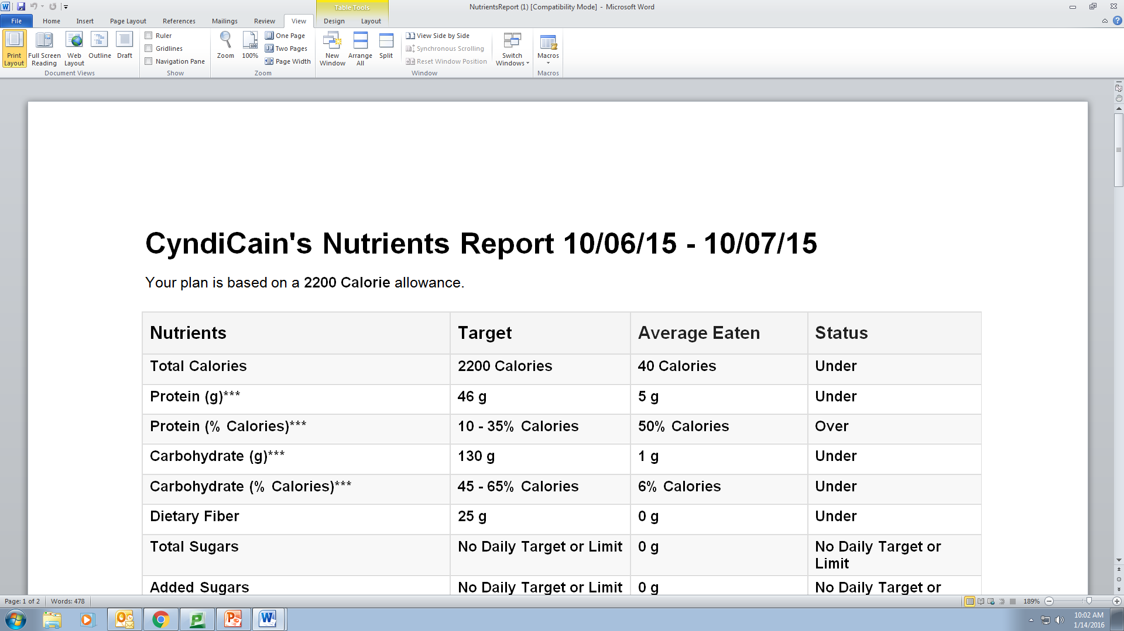
Part 4: My Reports: Nutrients Report

Slide 40
Part 5: Self-Assessment Paper
-200 Words minimum typed
-5 paragraphs, 3 sentences each
Paragraph #1: I am not meeting my recommended number or calories. I averaged ….I should…
Paragraph #2: I eat a balanced diet, including all five food groups…..not enough??? Too much???
Paragraph #3: The nutrients that my diet is good in are vitamins but very low in minerals….. I eat way too much fat and not enough protein….
Paragraph #4: Some good thing s I noticed about my diet are….lots of vegetables, healthy fats…
Paragraph #5: I have learned that…..

Slide 41
Part 6: SMART Goal
Goal: I will eat more fruit.
Specific
•Eat 1 piece of fruit at breakfast this week.
•Next week add fruit to lunch.
Measurable
•Measure with measuring cup and write down how much fruit I eat each day. Log….in MyFitnessPal
ACTIONALBE Achievable/Attainable
•I am going to start by eating 1 pieces of fruit daily, then adding 1 more per week.
Relevant
•Actually adding more fruit throughout the day.
•Breakfast, lunch, snack, dinner, and snack.
Timely
•This week I am going to add 1 more fruit, next week add 2, then 3, 4 and 5. =5 after 5 weeks!

Slide 42
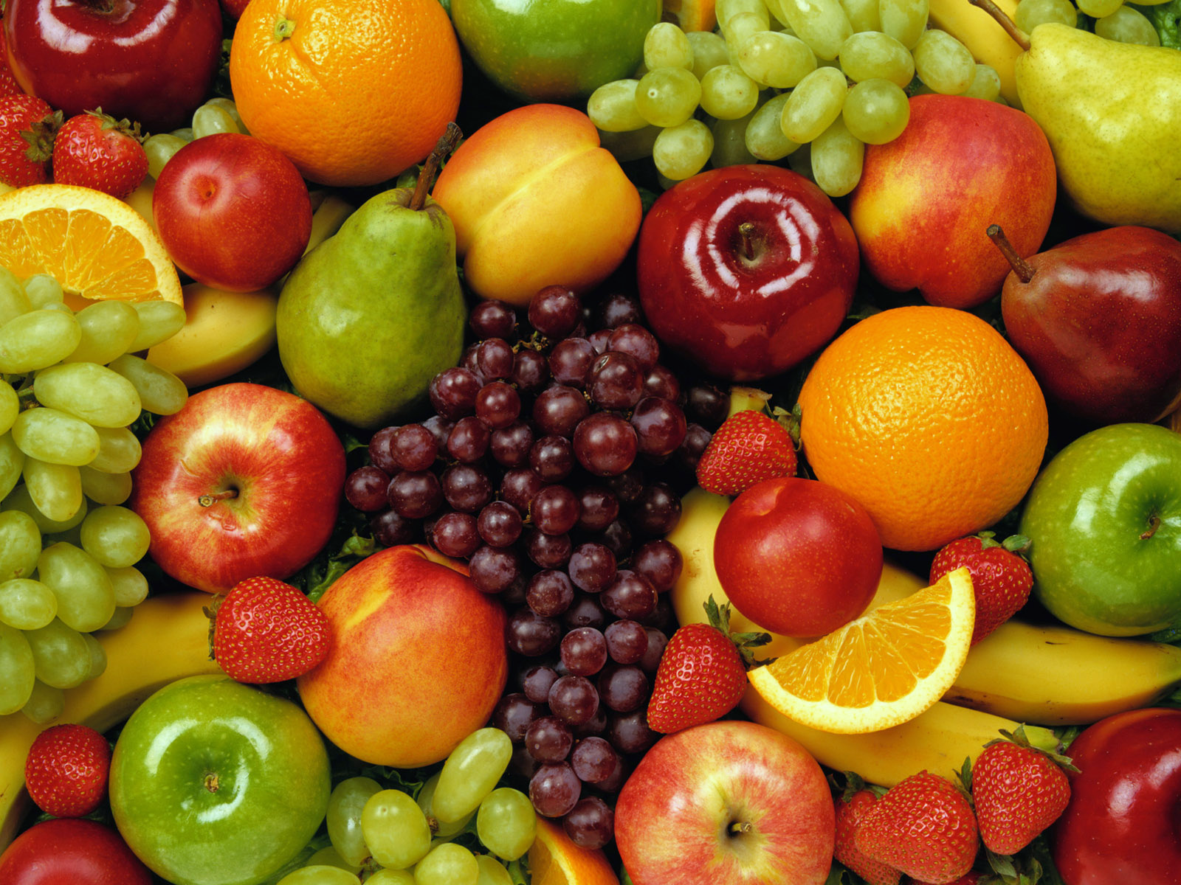
Focus on fruits
Serving: 2 cups
Any fruit or 100% fruit juice
Fresh, canned, frozen or dried
Commonly eaten fruits:
  Apples
  Bananas
  Kiwi
  Mangoes
  Peaches

Slide 43
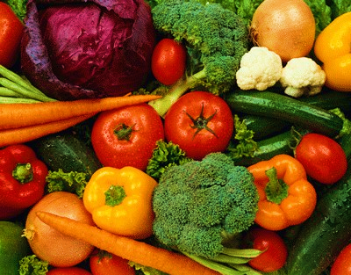
Vary your vegetables
Serving: 2 ½ - 3 cups
Any vegetable or 100% vegetable juice
Raw or cooked; fresh, frozen, canned or dried/dehydrated
Organized into 5 subgroups – based on nutrient content
  Dark Green
  Starchy
  Red & Orange
  Beans & Peas
  Other

Slide 44
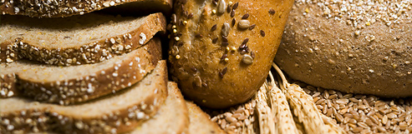
Make half your grains whole
Serving: 3-4 ounces
Any food made from wheat, rice, oats, cornmeal, barley or another cereal grain
  Whole Grains:
    Contain entire grain kernal – the bran, germ, and enosperm
    Whole wheat bread, brown rice, wild rice
  Refined Grains:
    Milled; process that removes the bran and germ
    White bread, white rice, pretzels

Slide 45
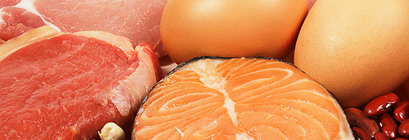
Go lean with protein
Serving: 5 ounces
All foods made from meat, poultry, seafood, beans and peas, nuts and seeds
Commonly eaten protein foods:
  Beef, ham, pork
  Chicken, turkey
  Chicken eggs
  Black beans
  Chickpeas

Slide 46
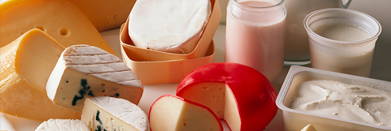
Get your calcium-rich foods
Serving: 3 cups
Fluid milk and products made from milk
Switch to fat-free or low fat (1%) milk
Commonly eaten daily products
  Cheese
  Yogurt
  Ice cream
  Pudding

Slide 47

Oils
Oils are fats that are liquid at room temperature (plant and fish sources)
  NOT a food group, but provides essential nutrients
Commonly eaten oils:
  Conola oil
  Corn oil
  Olive oil
  Sunflower oil

